Slide 1
HERB GARDEN
Herbs, spices and other vegetables
Unit: SENICA sloni, levi in žirafe
Autors: Maja Knific Bukovšak in Maja Burgar

Slide 2
GOAL
Allow children to to learn actively from the experience.
Acquire useful practical knowledge.
Actively participate in the preparation of the garden, editing, caring for plants and with experience acquire useful habits.
Learning in nature and with nature.

Slide 3
ACTIVITIES - Talks about growing plants in our garden. - Digging, planting, watering, ...

Slide 4
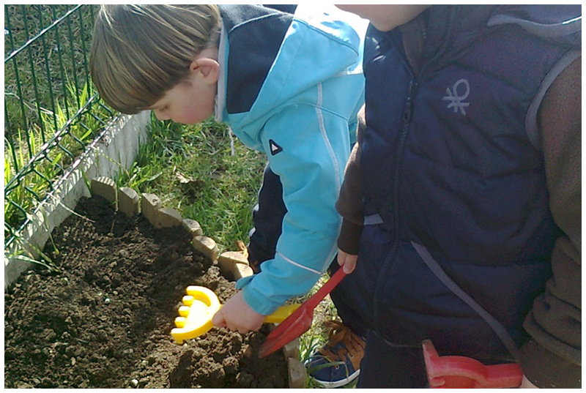
Preparing garden beds in the fall.

Slide 5
Planting herbs and other vegetables in small pots.
Observing the sprouting and growth.

Slide 6
Makeing poster

Slide 7
Observing the sprouting and growth
… with a magnifying glass

Slide 8
Painting
Observation of sprouting and growth with a magnifying glass

Slide 9
Smelling herbs and finding pairs
In the bags were various types of herbs which children had to help determine the smell to finding pairs.

Slide 10
Tasting and smelling different herbal teas
Meta
chamomile
Pomegranate, ...

Slide 11
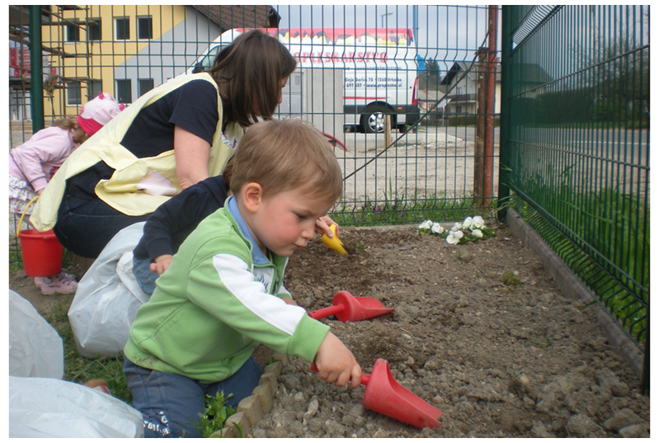
Preparing garden beds in the spring
Children have enjoyed very much when we edit billet.

Slide 12
Transplant herbs and vegetables in pots on billet
Meta
thyme
The Basilica
Rosemary ...

Slide 13
Assistance with outdoor billet
Children love to remove weeds;).

Slide 14
Our crops
we look at our garden every day, how herbs and radishes grow ...

Slide 15
Reading books
- HOW Mole welcomed MOUSE
(Zdenek Miler)
- HERBS Little Witch
(Polona Kovač)
- MEADOW healer
(Štok-Vojska)

Slide 16
WHAT CHILDREN LEARN
Children have learn about beneficial and healing effects of certain plants.
Knowledge which they have acquired in the books and the conversations, can be practically verified.
Children are participated, gain a sense of belonging and nurture socially responsible relation to nature.

